Slide 1
Extragalactic Astrophysics and Cosmology Group Study 2013
Predictions Group Seminar

Slide 2
Our Aims:
To be able to predict the number of galaxies present during the epoch of Cosmic Reionization.
To find the high redshift limit of this epoch through star formation rates.
To calculate the number of UV photons available to re-ionize the neutral hydrogen in the IGM in order to obtain an estimate for the lower redshift limit.

Slide 3
How we have done this:
Built a program to automate process of calculating number of galaxies using Schechter Function.
Found plausible starting parameters and determined their evolutions with time to incorporate into program.
Determined how cosmic variance affects the number of galaxies.
Plotted results to display data in a more ‘user friendly’ way.
Give an estimate of the number of galaxies to the observers.
Estimated the redshift range of Cosmic Reionization using star formation rates.

Slide 4

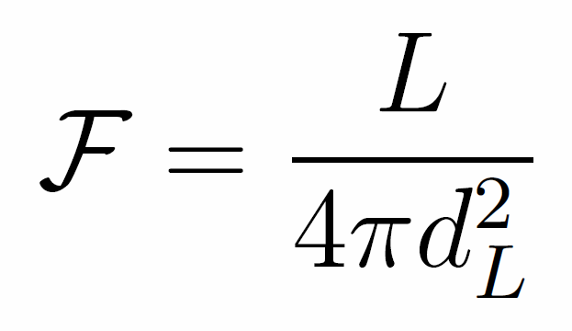
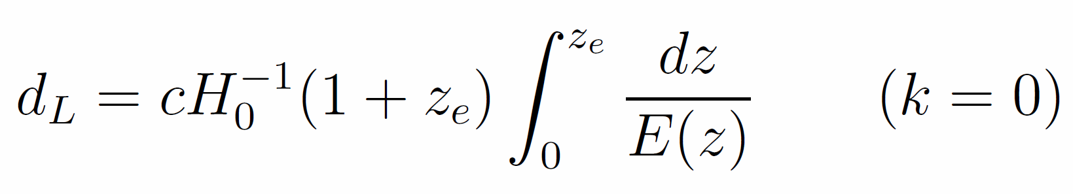
Cosmological Distances
Co-moving Distance
Luminosity Distance
Magnitude Conversion
Notes:
dH (hubble distance) radius of the visible universe. Luminosity distance is redshifted. Magnitude conversion is for AB system. Get volume from comoving volume.

Slide 5

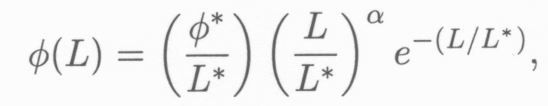

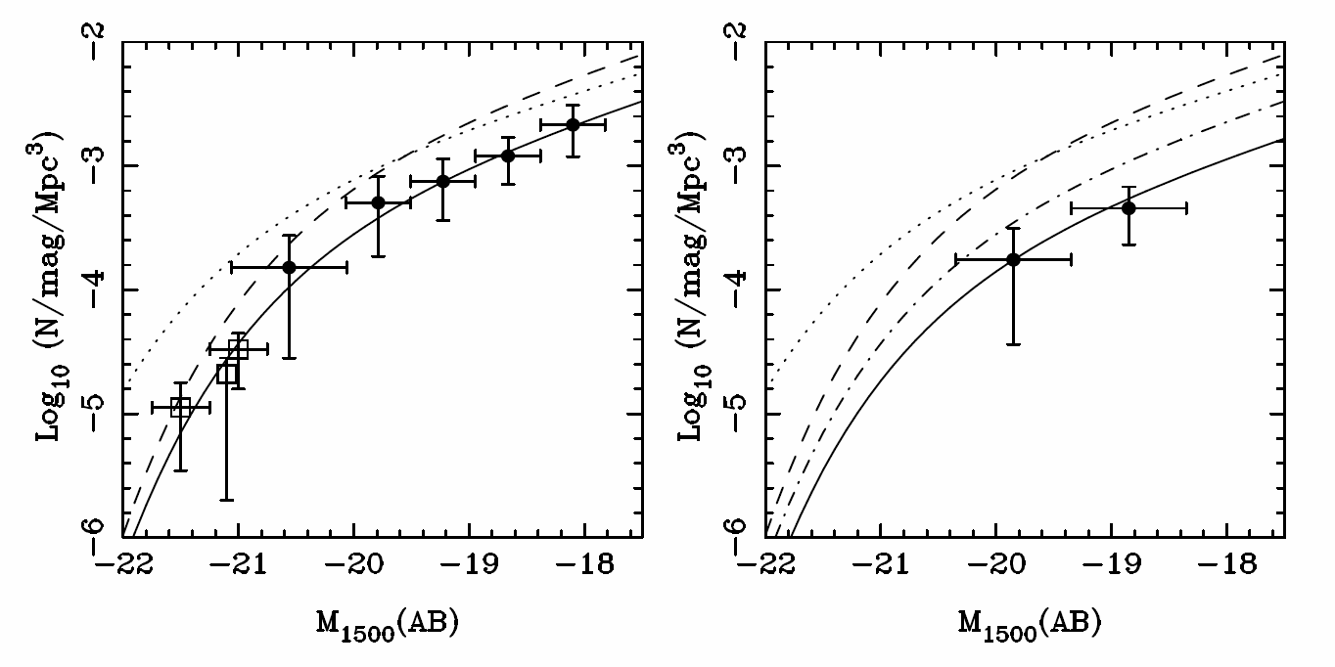
Schechter Function
Z=7
Z=8
(McLure, 2010)

Slide 6


Schechter Function
Number Density:
Luminosity Density:

Slide 7
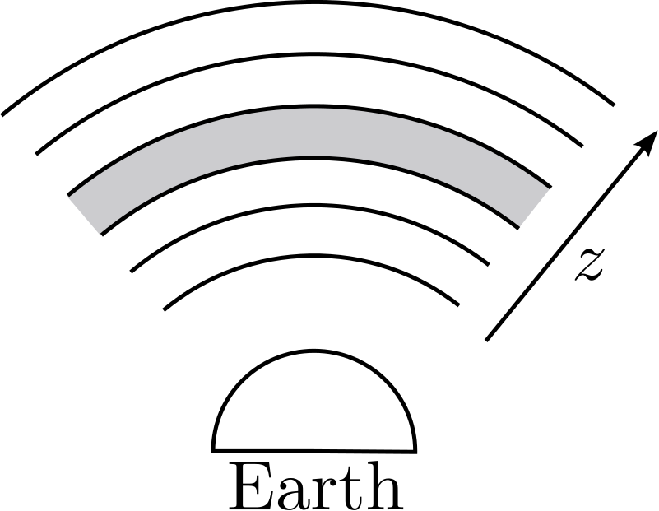
Assumptions
Universe is:
Flat
Matter Dominated
No cosmic variance
AB Magnitude system
Magnitude to Flux Density
Schechter Function
Parameters of the Schechter function do not change as a function of redshift.
Evolution is as predicted by data.

Slide 8
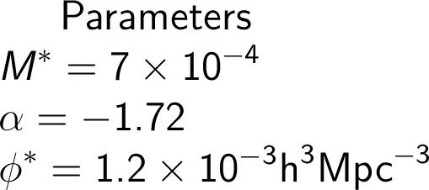
Parameters
Parameters taken from papers on high redshift galaxies.
Started with constant values, moved on to parameter evolution with redshift.
Characteristic Magnitude
Faint End Slope Gradient
Normalisation Factor

Slide 9
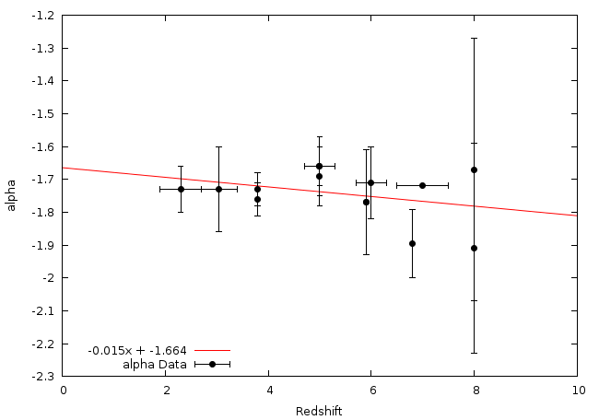

alpha Evolution - Linear

Slide 10
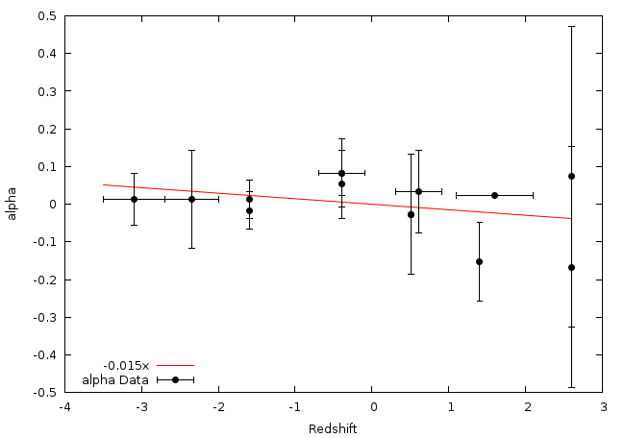
alpha Evolution - Pivot

Slide 11
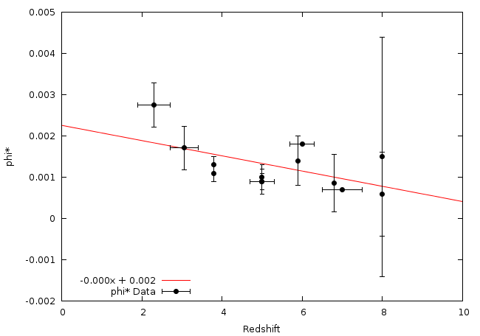
phi* Evolution - Linear

Slide 12
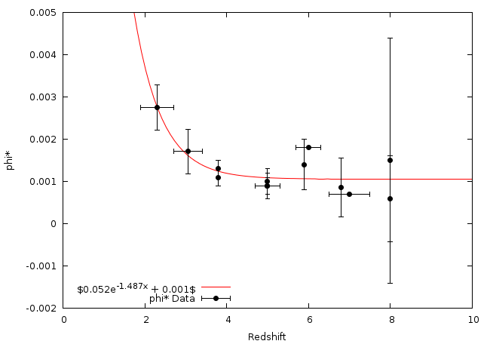
phi* Evolution - Exponential

Slide 13
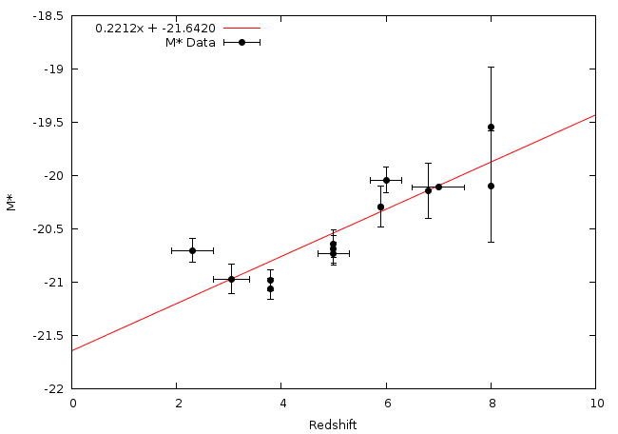
M* Evolution - Linear

Slide 14
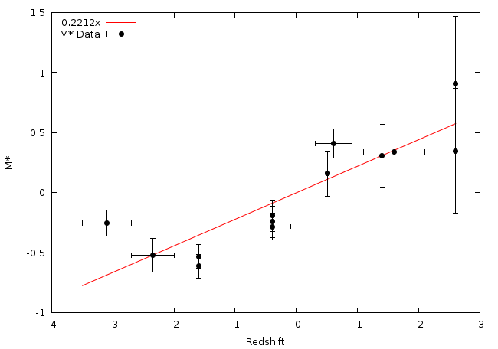

M* Evolution - Pivot

Slide 15
The Programs
We have created two programs designed to compute the same quantities in slightly different ways in order to validate any results we obtain.
These have been predominantly written by Owen and Andy.

Slide 16
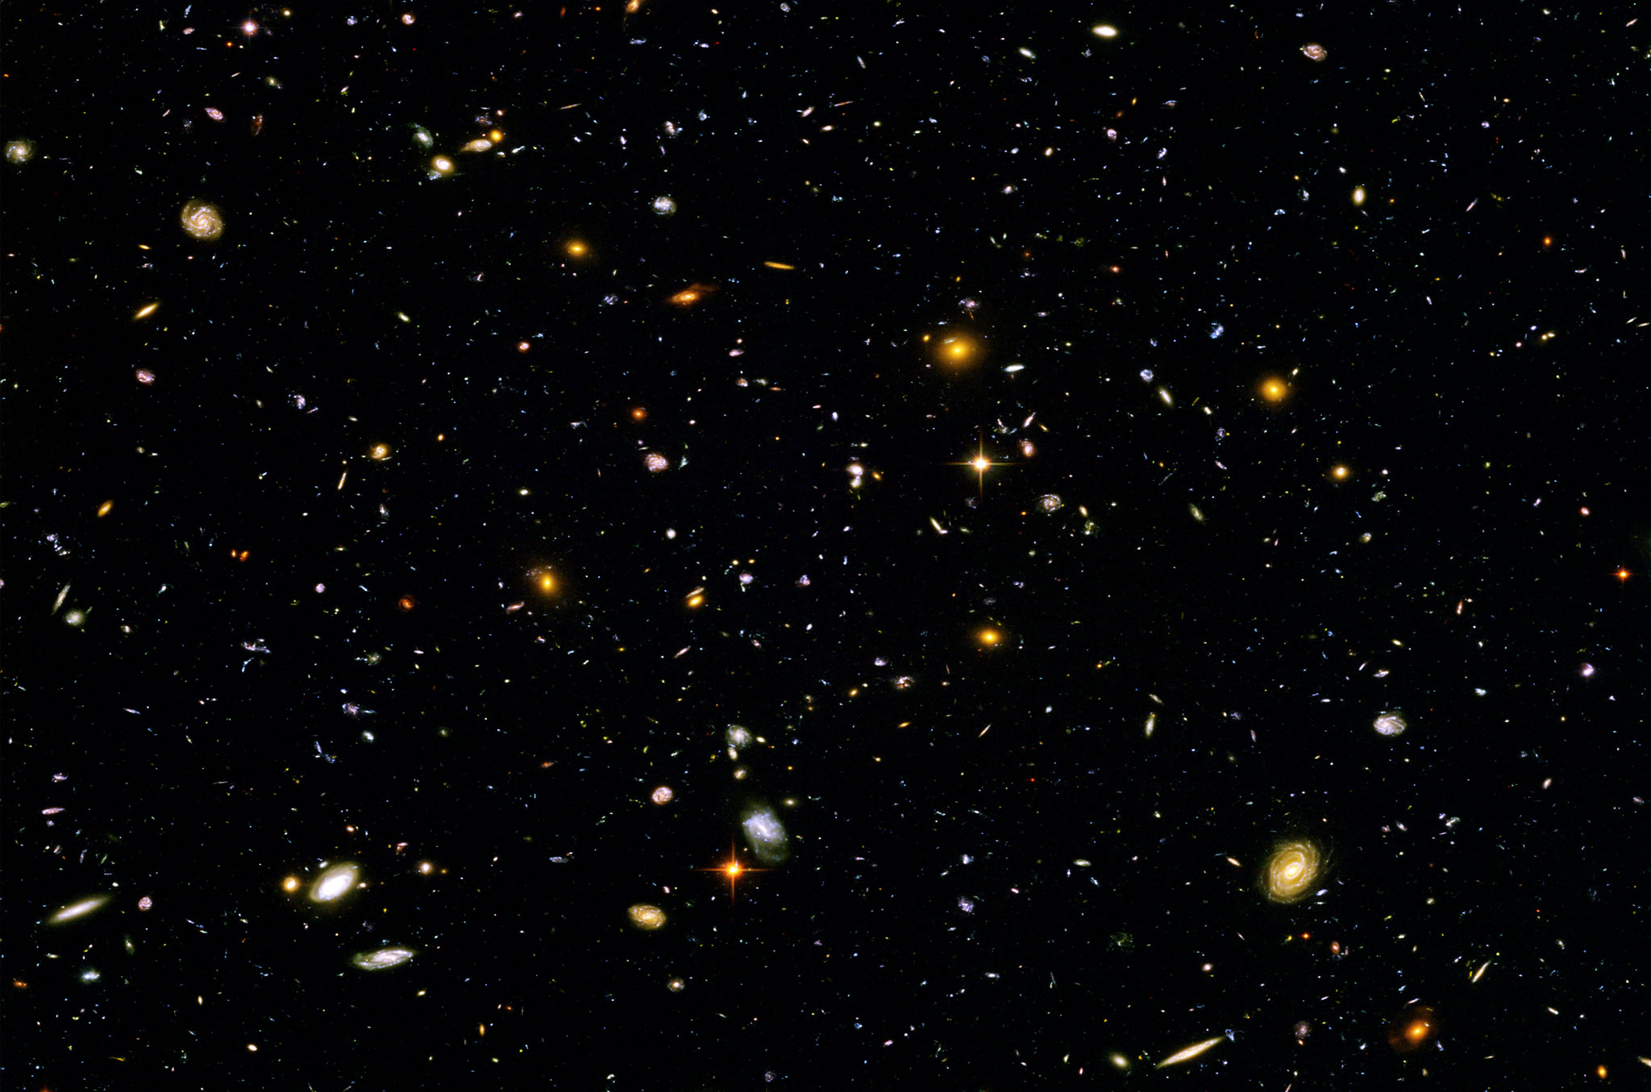
Finding the Number of Galaxies

Slide 17
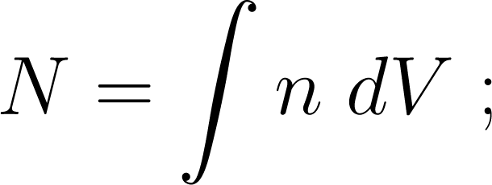
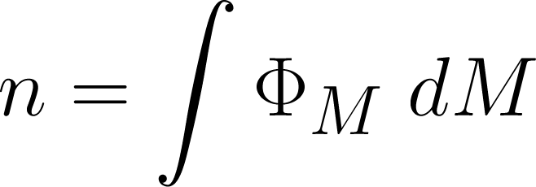
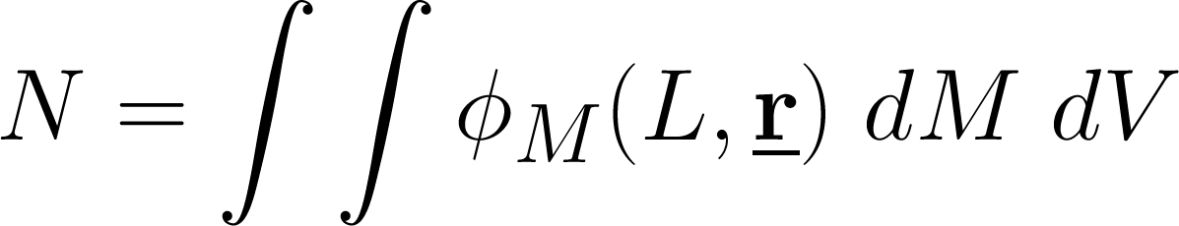
Method

Slide 18
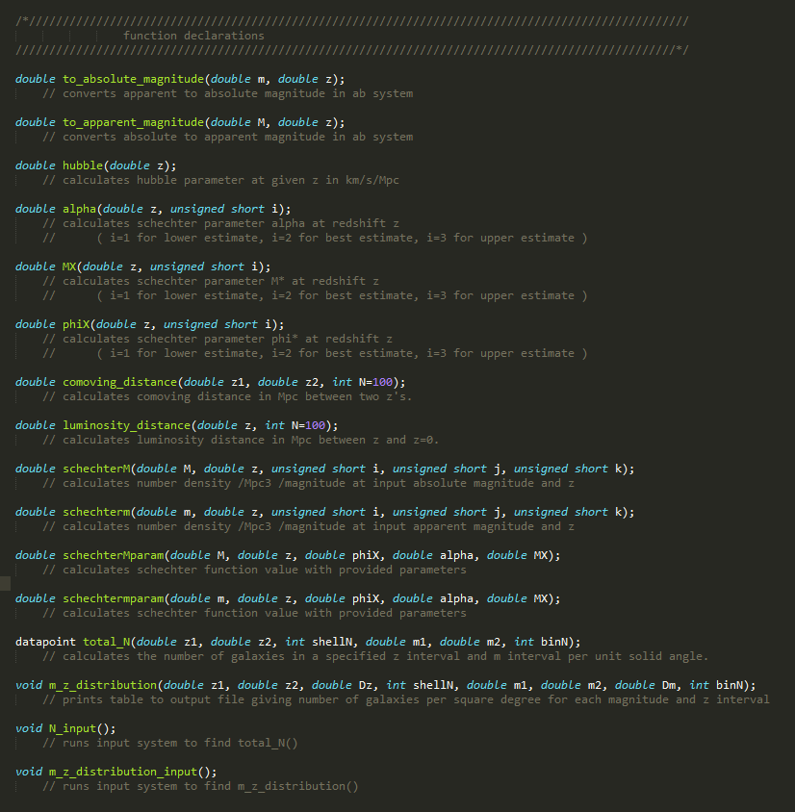
Code

Slide 19
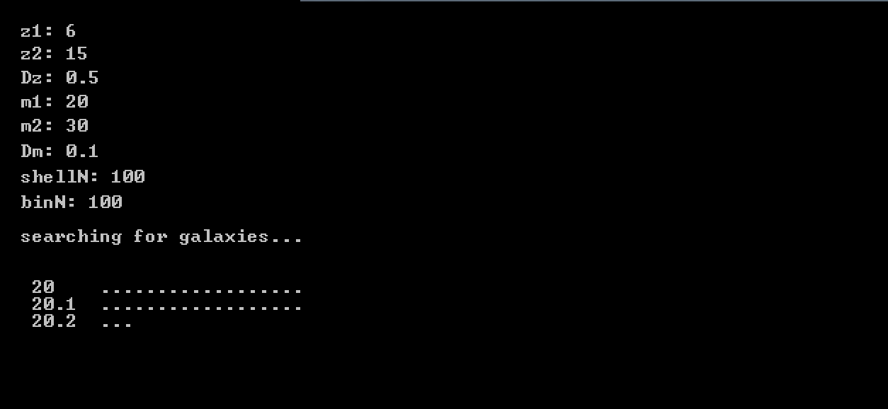
Input System
Simple input method
Limits are order independent
Loading bars to indicate progress

Slide 20
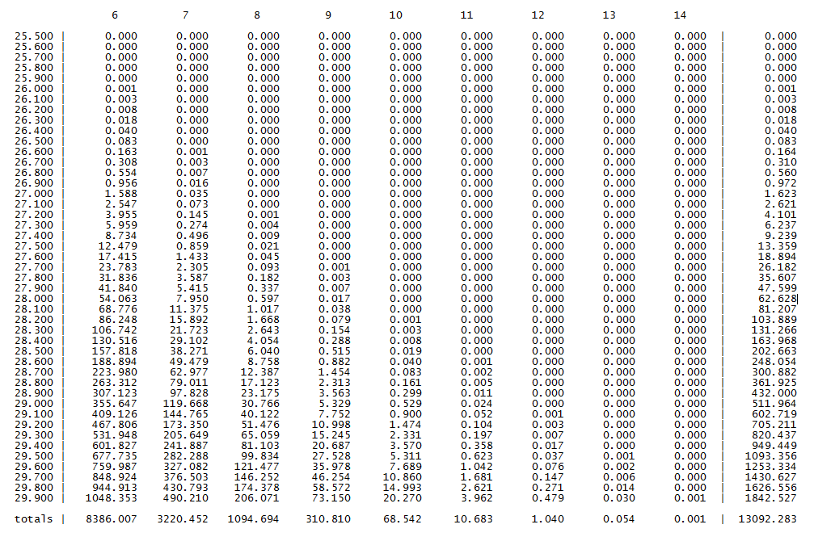
Output

Slide 33


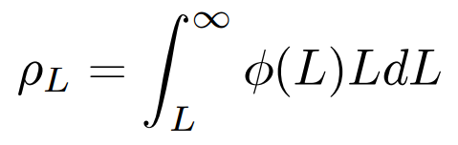


Calculating Higher Limit of Redshift
& Thereby Estimating Epoch of Reionization
Kennicutt (1998)
The z at which Reionization begins
is found from the luminosity density
is found from an analytical model

Slide 34
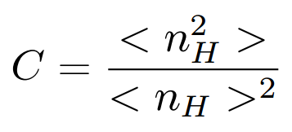
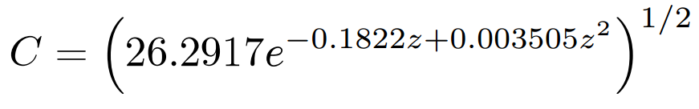
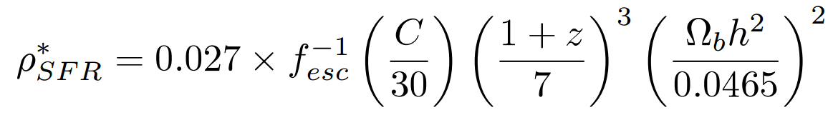
Critical Star Formation Rate Density
Recombination rate is proportional to clumping factor
Clumping Factor
Model
(Illev et al. 2007)
Critical Star Formation Rate Density relation
(Bagala et al. 2009)

Slide 35
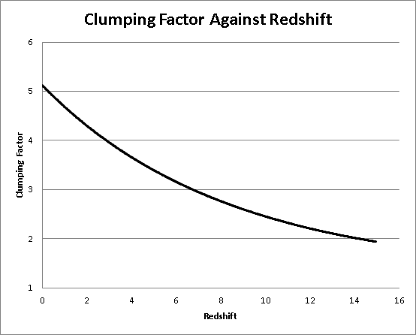

Slide 36
Star Formation Rate Density
Area under the schechter function is infinite unless L is specified
We need a lower luminosity limit
Lower Limit comes from lower mass → Jeans Mass

Slide 37
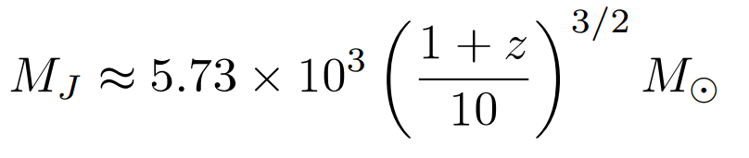
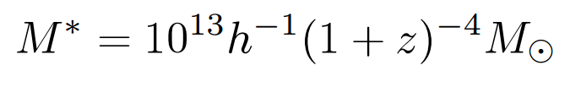
Minimum Luminosity
At z=106, MJ is approximately 1.1x10⁵
Using a Mass-Luminosity ratio of order unity
L≈1.1x10⁵ Solar Luminosity
Corresponds to Absolute Magnitude of -7.5

Slide 38
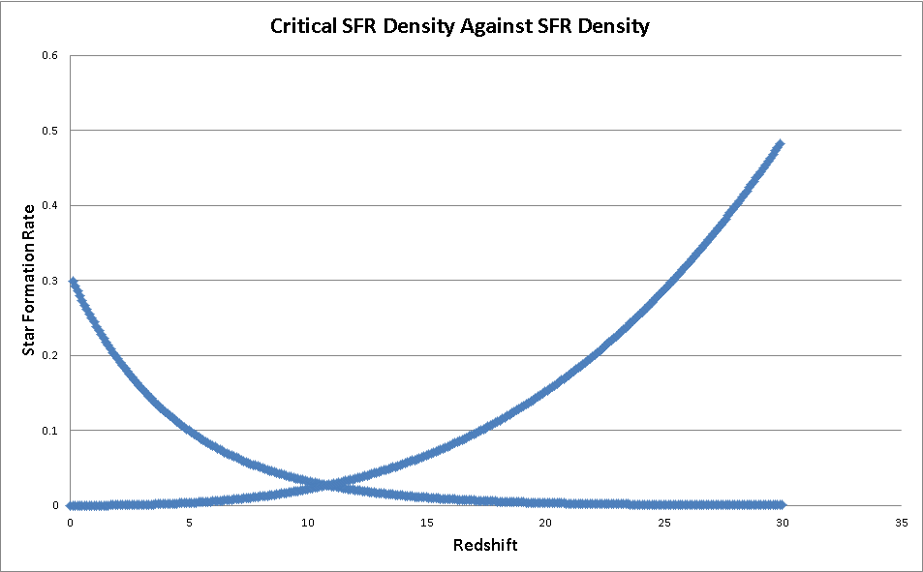
(Solar Masses per year per Megaparsec cubed)
Critical SFR Density
SFR Density

Slide 39
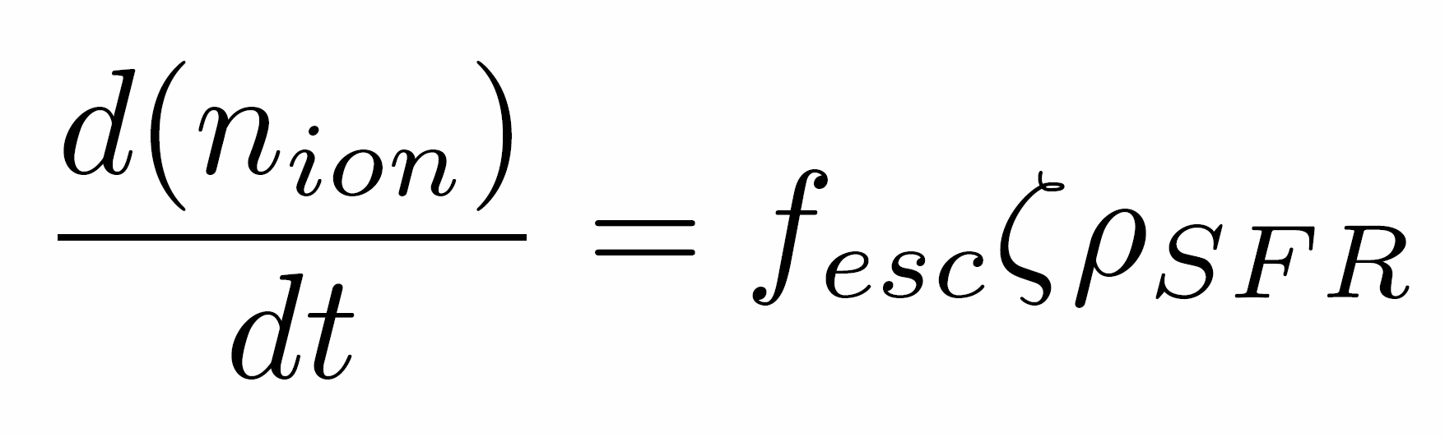


Lower redshift Limit of Reionization
Where assuming matter dominated epoch,

Slide 40
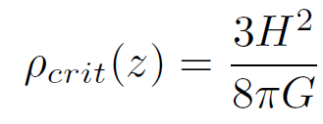
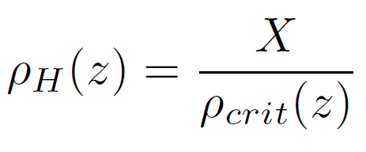
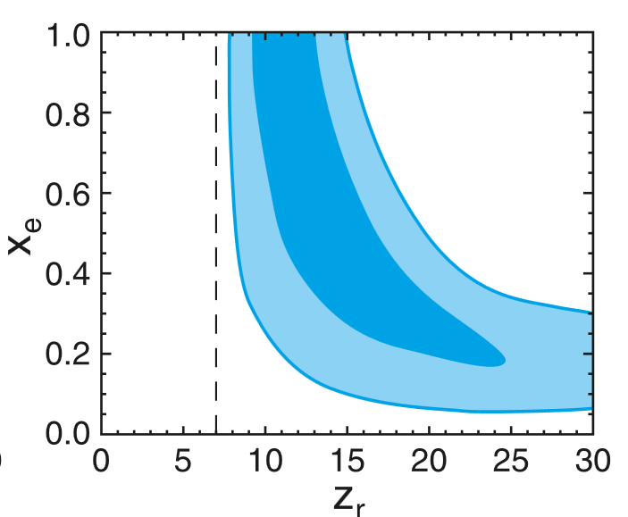
Lower redshift Limit of Reionization
Notes:
Taking primordial hydrogen fraction to be about 0.8064. fesc 0.2 and zeta 3e53. Get a 1 ionized fraction at about 6.5

Slide 41
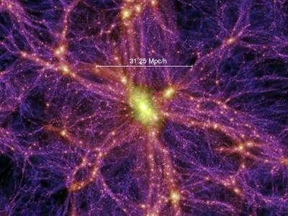

Cosmic Variance
Statistical uncertainty in any cosmological observation brought about by large-scale cosmic structure.
The Universe is only homogeneous at the largest scales (>1Gpc).
This will be the dominant source of error, well in excess of Poisson noise.
Any number or density measurement derived from a galaxy population is susceptible to Cosmic Variance.
Any cosmic survey should take account of Cosmic Variance.
Given by:

Slide 42
Including in the code
Any estimates produced for the observing team, from the code, should account for Cosmic Variance in some way.
The Cosmic Variance of a survey depends on:
Total survey volume.
Aspect ratio - lower for higher aspect ratio surveys.
Number of sightlines - empirically reduced with multiple sightlines, by √N – where N is the no. of sightlines.
We found an empirical formula for the Cosmic Variance for any galaxy survey, derived
using SDSS and extrapolated to higher redshifts.
Now, the program can give an estimate for Cosmic Variance for any survey the observers
choose to input. It also can give the appropriate number of random pointings or aspect
ratio necessary to reduce Cosmic Variance to below 10%.

Slide 43
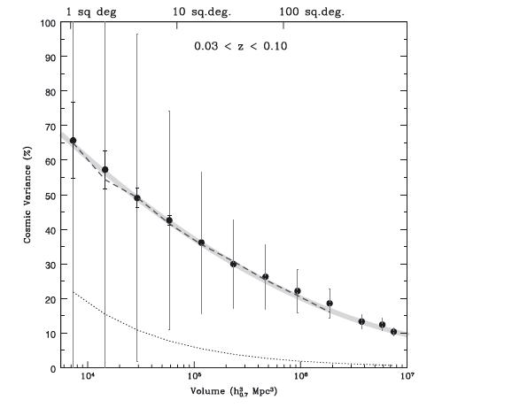
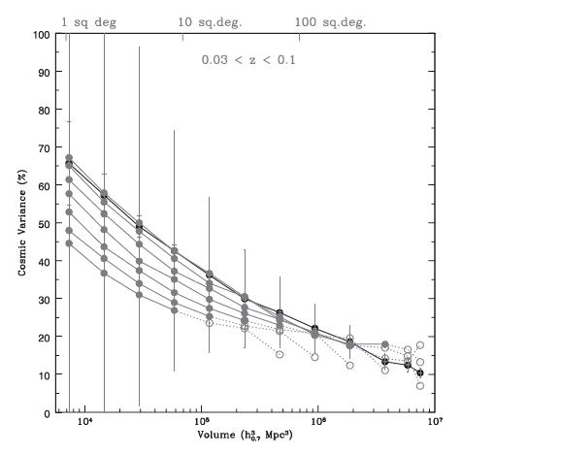

Slide 44
Summary:
The number of galaxies that should be present in x<z<x for a magnitude range of x<M<x is: x
The appropriate number of sightlines to reduce the effect of cosmic variance to below 10% for a given telescope and survey size can be calculated.
Or similarly for the preferred aspect ratio.
We expect that Cosmic Reionization began at a redshift of approximately z=14 and ended at z=x.

Slide 45
Any Questions?

